Slide 1
Internship Reporting – 15th January 2024
Anwar Bin Beduan
Report prepared by Anwar Bin Beduan
Date: 12 January 2024

Slide 2
Internship Report
Table of Content
1
Internship Training Plan
2
Objective Internship Training
3
List Project Assign
4
Challenges & Solution
5
Strengths & Weaknesses
6
Summary

Slide 3
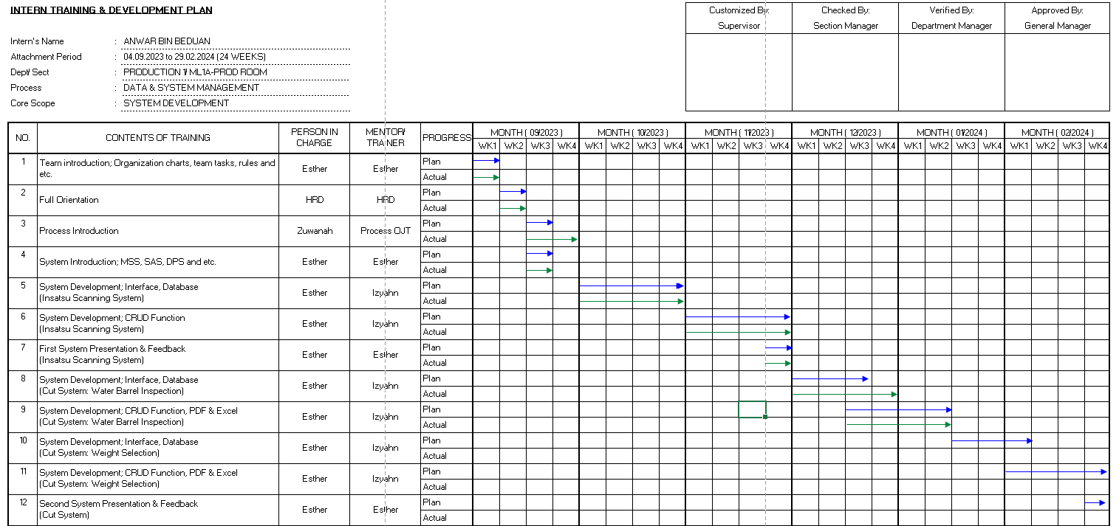
Internship Report
Internship Training Plan

Slide 4
Internship Report
Objective Internship Training
To expose students to real-world working environments, allowing them to gain practical experience beyond the theoretical knowledge acquired in the classroom.
To enhance the skills and competencies of students, providing them with hands-on experience in applying academic concepts to practical, work-related situations.
To prepare students for the challenges of the professional world by instilling in them the necessary skills, confidence, and adaptability required to seamlessly transition from academic settings to the workplace.

Slide 5
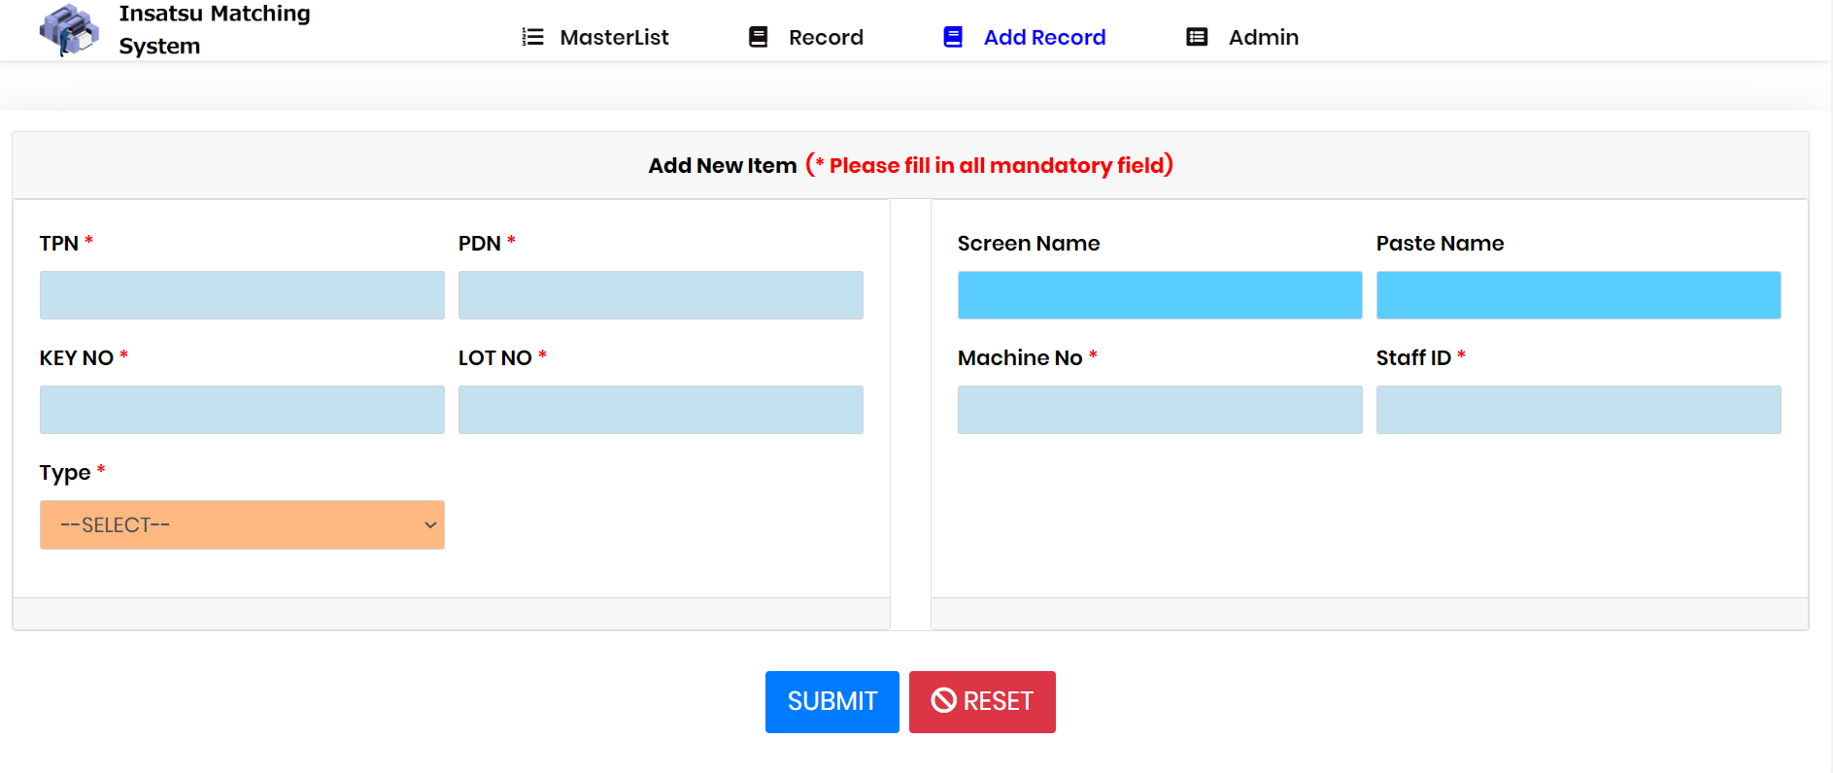
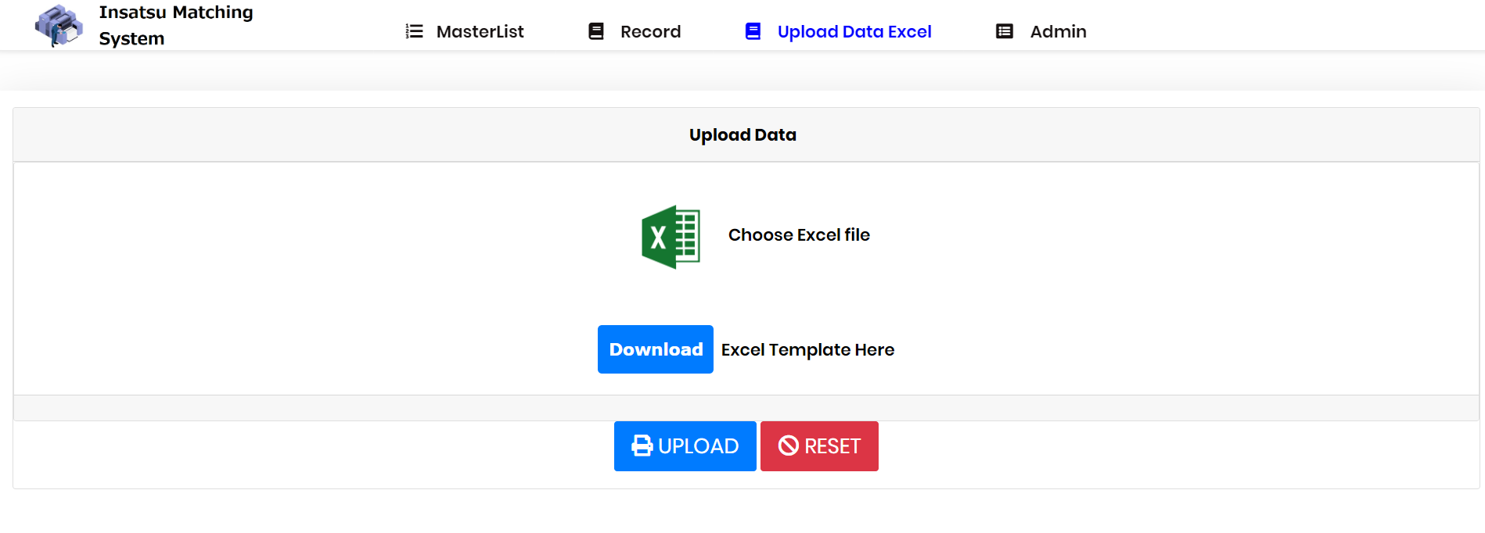
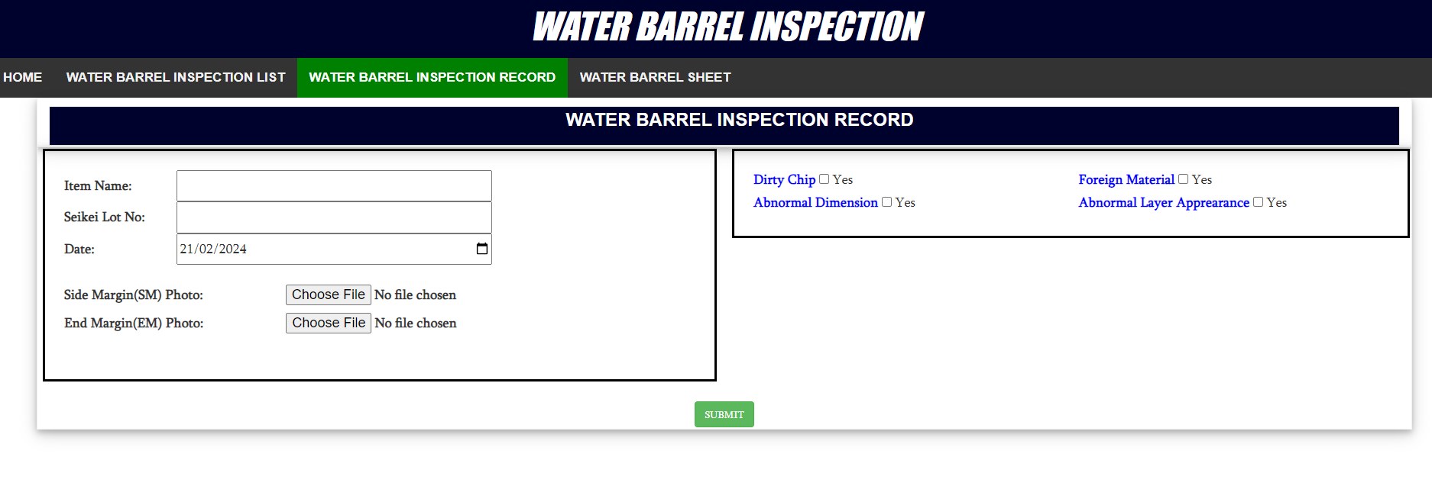
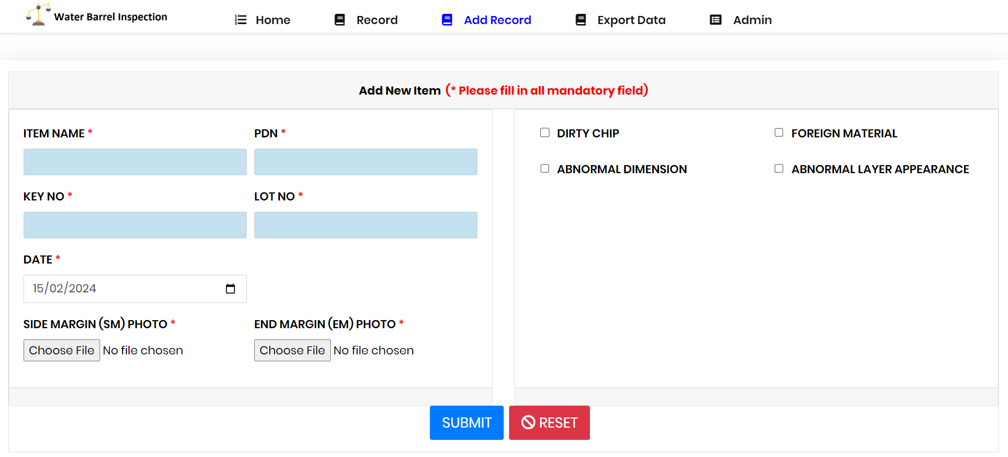
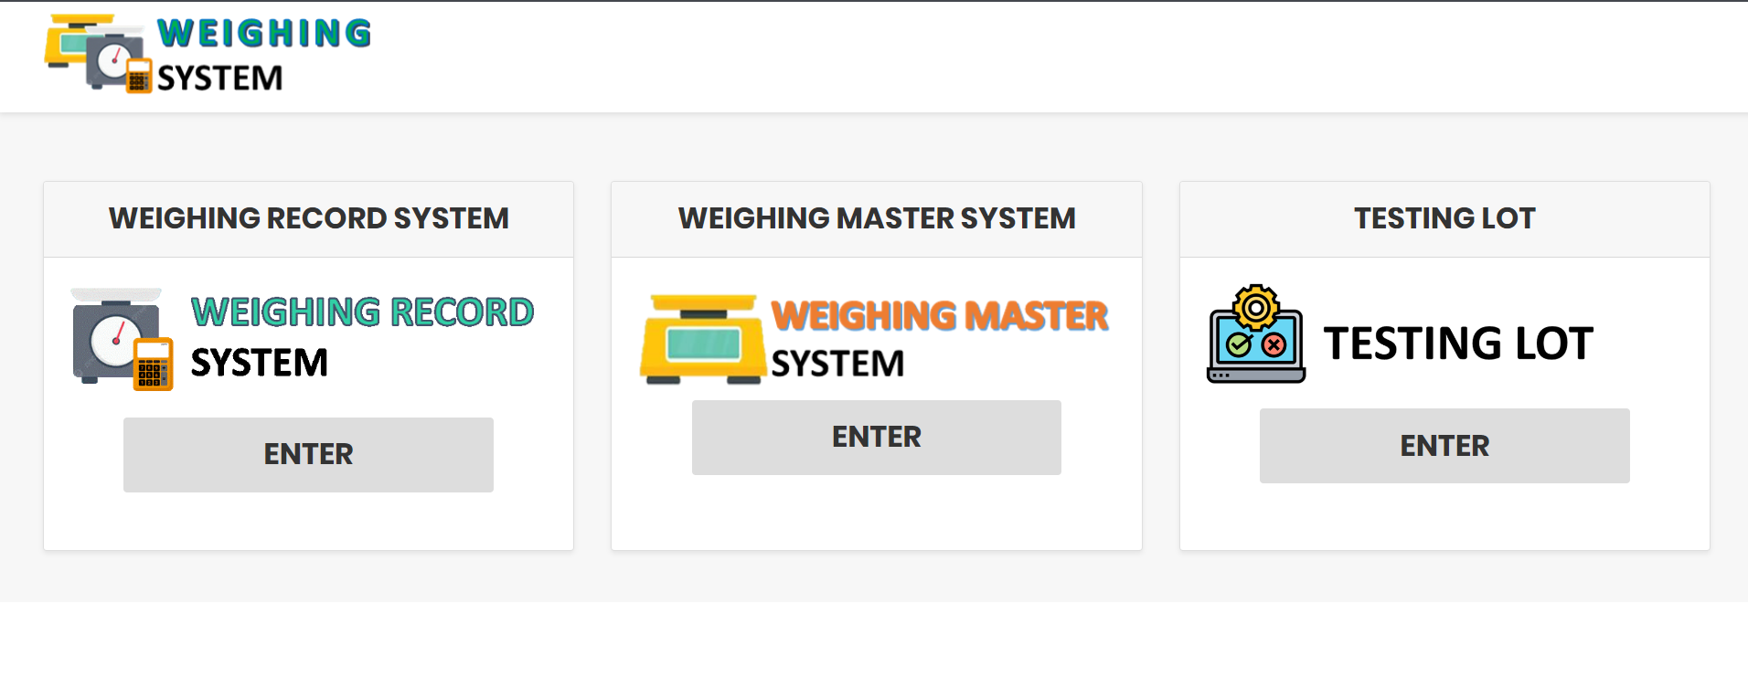
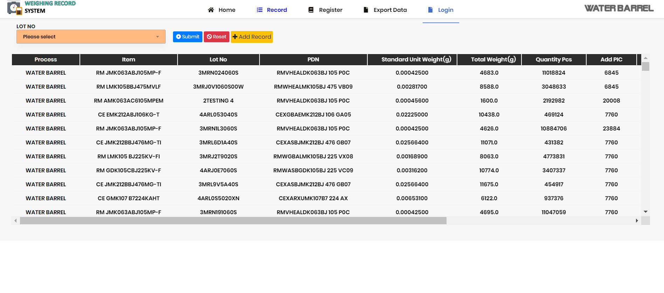
Internship Report
List Project Assign
Insatsu Matching System
Water Barrel Inspection System
Weighing System

Slide 6
Project Assign
Insatsu Matching System
The main purpose for this system is to prevent/reduce human error of taking the wrong roll, screen name & paste name by making matching system to match register data and actual item.
Water Barrel Inspection System
The main purpose for this project is to standardize the old system into new user interface system based on other process.
Weighing System
The main purpose for this project is to change minor design in current weighing system to make it standardize.

Slide 7
Internship Report
Challenges & Solution
Challenges | Solution
Lack of programming practice because of no consistency. | Manage to learn by applying basic knowledge of programming everyday on project/task given.
Internet dependent sources of programming code. | Using company tablet to browse the internet, sometimes browse the internet at home(during not working hour) and write the code in notes to bring them into office for references.
Process leaders request on their project. | Manage to completed the task as requested.

Slide 8
Internship Report
Strengths & Weaknesses
Strength | Weakness
The benefit for employee such as Panel clinic, meal & etc. | Lack of updated software technology.
The safety policy of the company. | Data restricted makes it hard to backup existing data.
The cleanliness of the company.

Slide 9
Internship Report
Summary
In summary, the internship training took six months to finished. Within that period, intern students have been given specific task they need to go through for training purposes which are to expose students to real-world working environments, enhance the skills and competencies of the students & prepare the students for the challenges of the professional world . Three project had been appoint to which are Insatsu Matching System, Water Barrel Inspection System & Weighing System. There are some challenges that I encountered for example difficult request from process leader for their project and thankfully I managed to solved the task given for me. Lastly, there is one strength point of Taiyo Yuden Sarawak SDN BHD that I want to highlight for example the safety policies that prioritize customer needs and their employee.

Slide 10




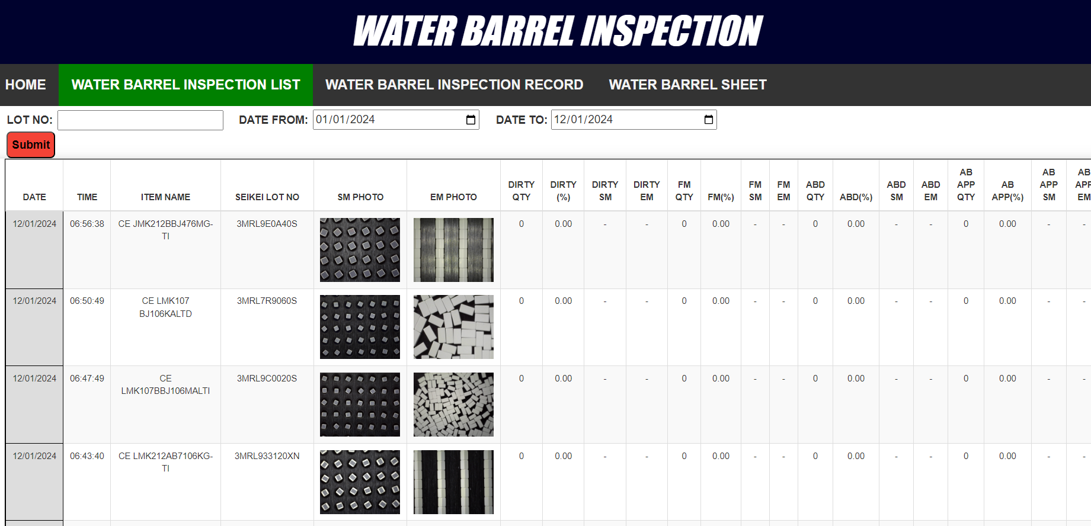
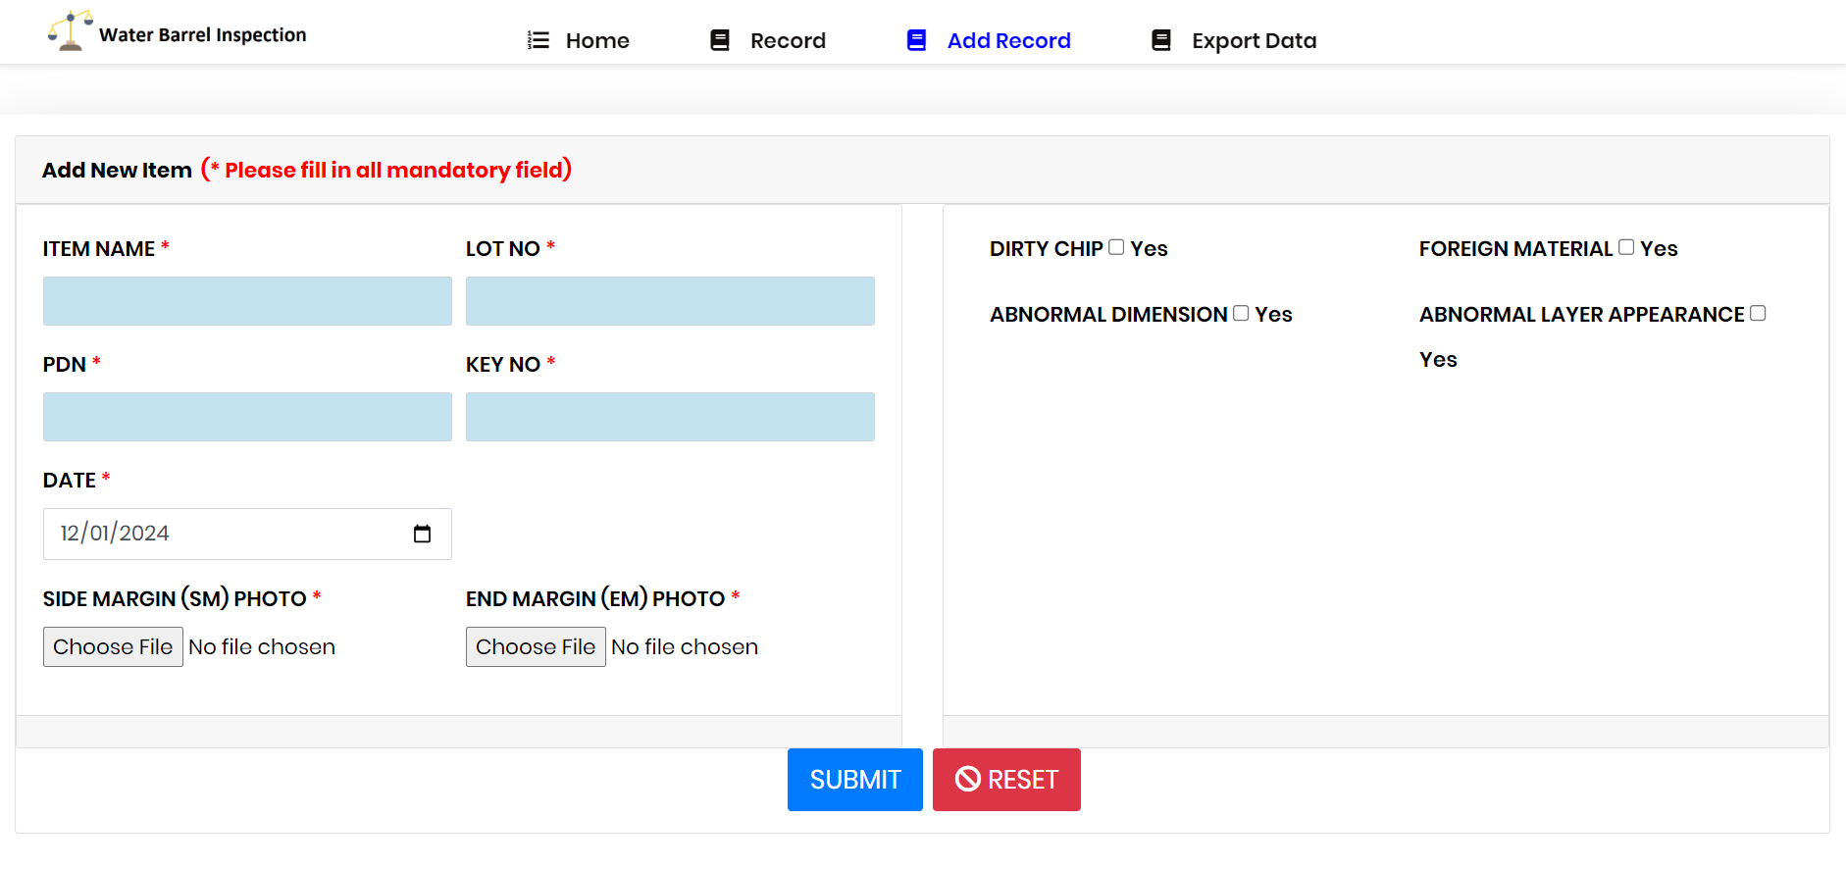
Internship Reporting
Insatsu Matching System
Data matched or unmatched will be detected after scanning actual item
Upload data excel into system
Scan data in workslip at the machine
Scan actual item based on registered data
Changing current existing system interface into new interface
Water Barrel Inspection
New interface with some new added function and input parts
Things I learnt
SQL on how to convert data into PDF file.
SQL on how to convert Excel file into database & convert data from database into Excel file.
SQL check data for duplicate data.
Learnt javascript function.
Things I achieved during Internship period
Improved my web developing skills.
Improved my communication skills.
Improved my time management.
Improvement
Comment
Software version are not up-to-date.
Hard to develop & implementing system without internet access.
Suggestion
Using updated software.
Internet access.

